Slide 1

Chapter 2 Application Layer
Computer Networking: A Top-Down Approach 8th edition n Jim Kurose, Keith Ross Pearson, 2020
Acknowledgement: Based on the textbook’s website: https://gaia.cs.umass.edu/kurose_ross/index.php
Notes:
Version History
8.1. Updates throughout, including a lot more animations. These are the ppt files used to make Chapter 2 online lectures in Sept. 2020.
8.0 (April 2020)
All slides reformatted for 16:9 aspect ratio
All slides updated to 8th edition material
Use of Calibri font, rather that Gill Sans MT
Add LOTS more animation throughout

Slide 2

Application layer: overview
P2P applications
video streaming and content distribution networks
socket programming with UDP and TCP
Principles of network applications
Web and HTTP
E-mail, SMTP, IMAP
The Domain Name System DNS

Slide 3




Video Streaming and CDNs: context
stream video traffic: major consumer of Internet bandwidth
Netflix, YouTube, Amazon Prime: 80% of residential ISP traffic (2020)
challenge: scale - how to reach ~1B users?
challenge: heterogeneity
different users have different capabilities (e.g., wired versus mobile; bandwidth rich versus bandwidth poor)
solution: distributed, application-level infrastructure

Slide 4

Multimedia: video
spatial coding example: instead of sending N values of same color (all purple), send only two values: color value (purple) and number of repeated values (N)
video: sequence of images displayed at constant rate
e.g., 24 images/sec
digital image: array of pixels
each pixel represented by bits
coding: use redundancy within and between images to decrease # bits used to encode image
spatial (within image)
temporal (from one image to next)
……………………..
……………….…….
frame i
temporal coding example: instead of sending complete frame at i+1, send only differences from frame i
frame i+1

Slide 5
Multimedia: video
spatial coding example: instead of sending N values of same color (all purple), send only two values: color value (purple) and number of repeated values (N)
CBR: (constant bit rate): video encoding rate fixed
VBR: (variable bit rate): video encoding rate changes as amount of spatial, temporal coding changes
examples:
MPEG 1 (CD-ROM) 1.5 Mbps
MPEG2 (DVD) 3-6 Mbps
MPEG4 (often used in Internet, 64Kbps – 12 Mbps)
……………………..
……………….…….
frame i
temporal coding example: instead of sending complete frame at i+1, send only differences from frame i
frame i+1

Slide 6


Streaming stored video
IMPORTANT
simple scenario:
Internet
video server
(stored video)
client
Main challenges:
server-to-client bandwidth will vary over time, with changing network congestion levels (in house, access network, network core, video server)
packet loss, delay due to congestion will delay playout, or result in poor video quality

Slide 7
Streaming stored video
IMPORTANT
Cumulative data
2. video
sent
video
recorded (e.g., 30 frames/sec)
3. video received, played out at client
(30 frames/sec)
network delay
(fixed in this example)
time
streaming: at this time, client playing out early part of video, while server still sending later part of video

Slide 8
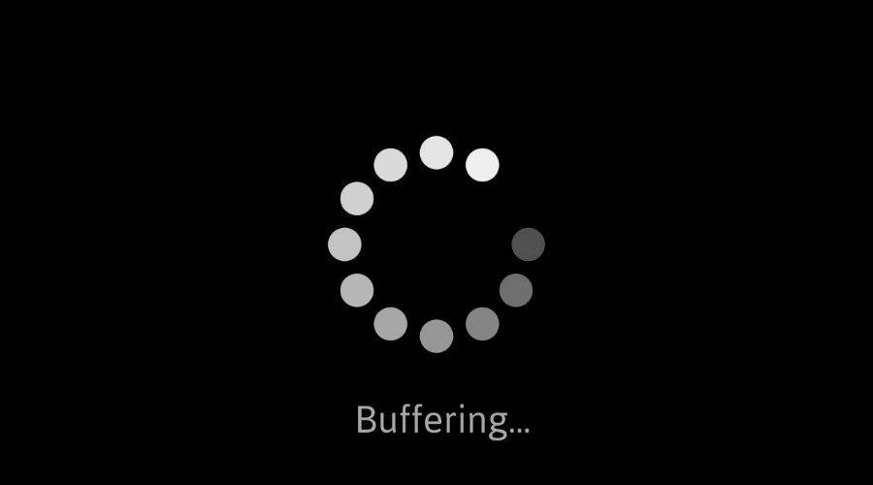
Streaming stored video: challenges
IMPORTANT
continuous playout constraint: during client video playout, playout timing must match original timing
… but network delays are variable (jitter), so will need client-side buffer to match continuous playout constraint
other challenges:
client interactivity: pause, fast-forward, rewind, jump through video
video packets may be lost, retransmitted

Slide 9
Streaming stored video: playout buffering
IMPORTANT
constant bit
rate video
transmission
client video
reception
constant bit
rate video
playout at client
Cumulative data
variable
network
delay
buffered
video
client playout
delay
time
client-side buffering and playout delay: compensate for network-added delay, delay jitter

Slide 10
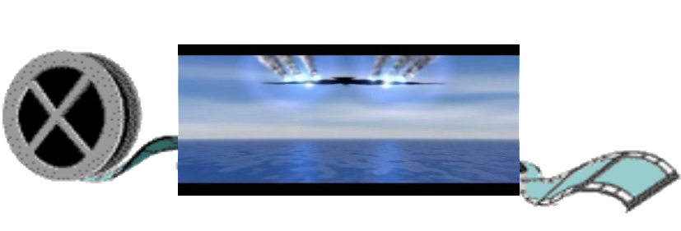
Streaming multimedia: DASH
Dynamic, Adaptive Streaming over HTTP
server:
divides video file into multiple chunks
each chunk encoded at multiple different rates
different rate encodings stored in different files
files replicated in various CDN nodes
manifest file: provides URLs for different chunks
...
...
?
...
client
client:
periodically estimates server-to-client bandwidth
consulting manifest, requests one chunk at a time
chooses maximum coding rate sustainable given current bandwidth
can choose different coding rates at different points in time (depending on available bandwidth at time), and from different servers

Slide 11

Streaming multimedia: DASH
“intelligence” at client: client determines
when to request chunk (so that buffer starvation, or overflow does not occur)
what encoding rate to request (higher quality when more bandwidth available)
...
...
?
...
client
where to request chunk (can request from URL server that is “close” to client or has high available bandwidth)
Streaming video = encoding + DASH + playout buffering

Slide 12
Content distribution networks (CDNs)
IMPORTANT
challenge: how to stream content (selected from millions of videos) to hundreds of thousands of simultaneous users?
option 1: single, large “mega-server”
single point of failure
point of network congestion
long (and possibly congested) path to distant clients
….quite simply: this solution doesn’t scale

Slide 13


Content distribution networks (CDNs)
IMPORTANT
challenge: how to stream content (selected from millions of videos) to hundreds of thousands of simultaneous users?
option 2: store/serve multiple copies of videos at multiple geographically distributed sites (CDN)
enter deep: push CDN servers deep into many access networks
close to users
Akamai: 240,000 servers deployed
in > 120 countries (2015)
bring home: smaller number (10’s) of larger clusters in POPs near access nets
used by Limelight

Slide 14
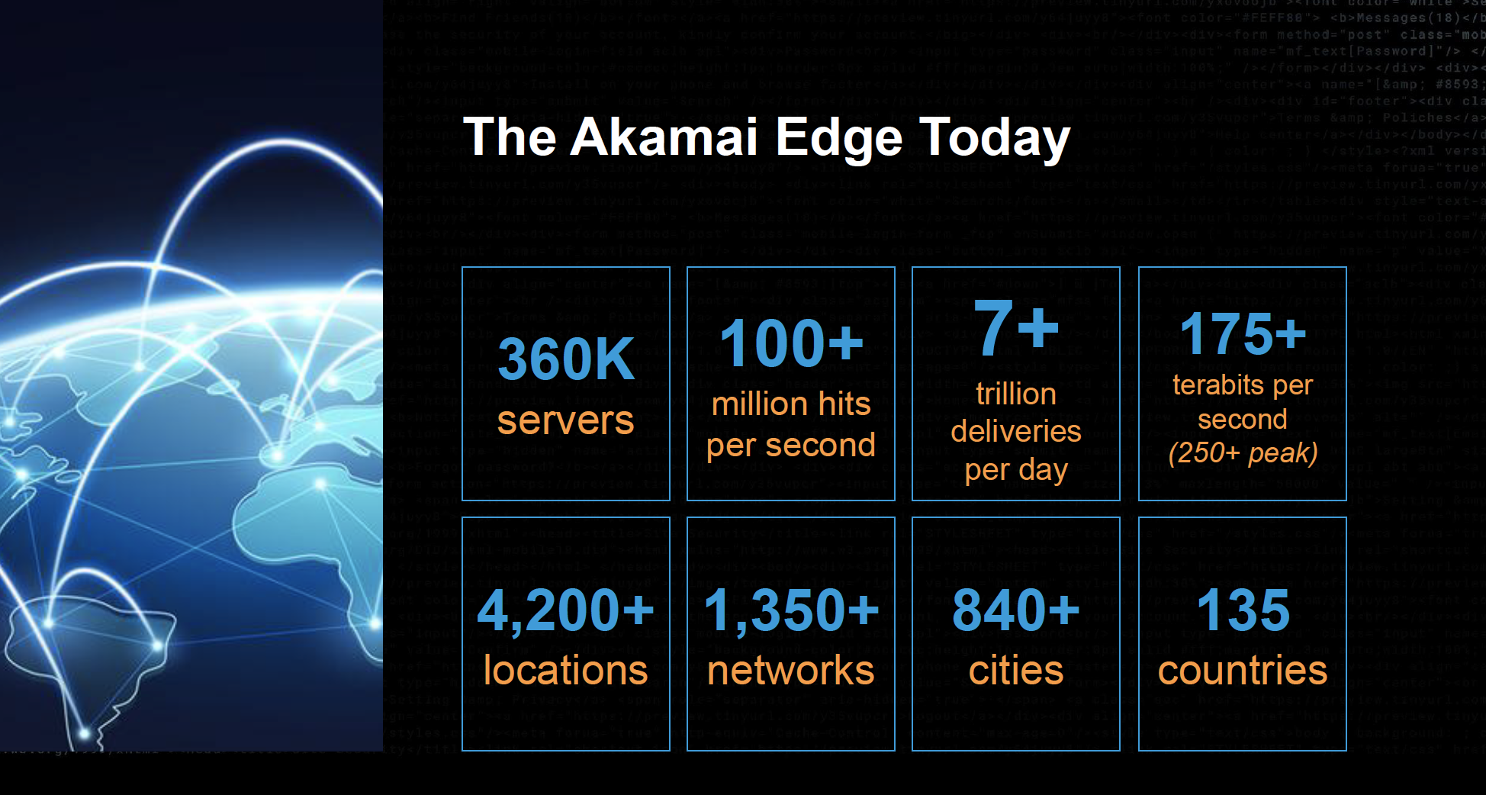
Akamai today:
Source: https://networkingchannel.eu/living-on-the-edge-for-a-quarter-century-an-akamai-retrospective-downloads/

Slide 15



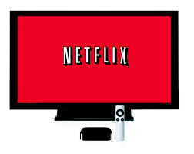
How does Netflix work?
Netflix: stores copies of content (e.g., MADMEN) at its (worldwide) OpenConnect CDN nodes
subscriber requests content, service provider returns manifest
using manifest, client retrieves content at highest supportable rate
may choose different rate or copy if network path congested
…
…
…
manifest file
…
where’s Madmen?
…
…
Notes:
15
Akamai: 100,000+ servers in 1000+ clusters in 1000+ networks in 70+ countries serving trillions of requests a day.
How many people use Netflix?

Slide 16
Content distribution networks (CDNs)
OTT: “over the top”
…
…
Internet host-host communication as a service
…
…
OTT challenges: coping with a congested Internet from the “edge”
what content to place in which CDN node?
from which CDN node to retrieve content? At which rate?
…
…
Notes:
16
peak load: 7million viewers, 2 Tbytes via

